Slide 1


VISVESVARAYA TECHNOLOGICAL UNIVERSITY
Jnana Sangama, Belagavi-590014, Karnataka, INDIA
SIR M. VISVESVARAYA INSTITUTE OF TECHNOLOGY
HUNASAMARANAHALLI, BENGALURU -562157
DEPARTMENT OF INFORMATION SCIENCE AND ENGINEERING
PROJECT ON
ON
INTELLIGENT VOICE ASSISTANT
Guided By-
Dr. VaniPriya CH
Associate Professor, Dept. of ISE
Sir MVIT, Bengaluru
Dr. P VijayKarthik
HOD ISE, Sir MVIT, Bengaluru
Presented By- Aditya Keshri Arun Kumar Avinash Kumar
1MV16IS004
1MV16IS013
1MV16IS016

Slide 2
Introduction
The goal of this project is to take input(or command) from the user as speech and intelligently (using NLP algorithms) reply or perform the desired task.
The project also aims to establish a standalone device/application as an intelligent virtual assistant depending upon the requirements (commercial, personal use etc).
Voice assistants come in somewhat small packages and can perform a variety of actions after hearing your command. They can turn on lights, answer questions, play music, place online orders and do all kinds of AI-based stuff.

Slide 3
Motivation
Speech processing has been an area of interest for the last four decades, but the last decade has witnessed significant progress in this area of research. This progress has been possible mainly due to the recent advances made in the powerful and efficient speech processing techniques such as vector quantization, hidden Markov Model etc.
The recent advancements in the field of speech and language processing has made it reachable and affordable to everyone thus opening a wide area of developments and improvements.

Slide 4
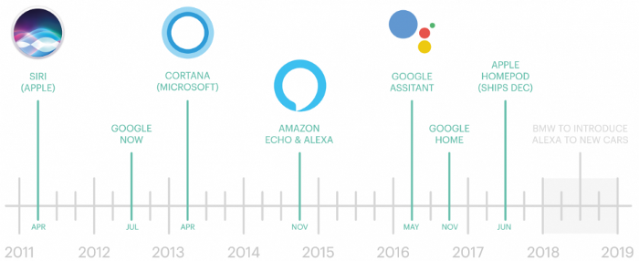
What is a Voice Assistant?
A voice assistant or intelligent personal assistant is a software agent that can perform tasks or services for an individual based on verbal commands i.e. by interpreting human speech and respond via synthesized voices. Users can ask their assistants’ questions, control home automation devices, and media playback via voice, and manage other basic tasks such as email, to-do lists, open or close any application etc with verbal commands.

Slide 5
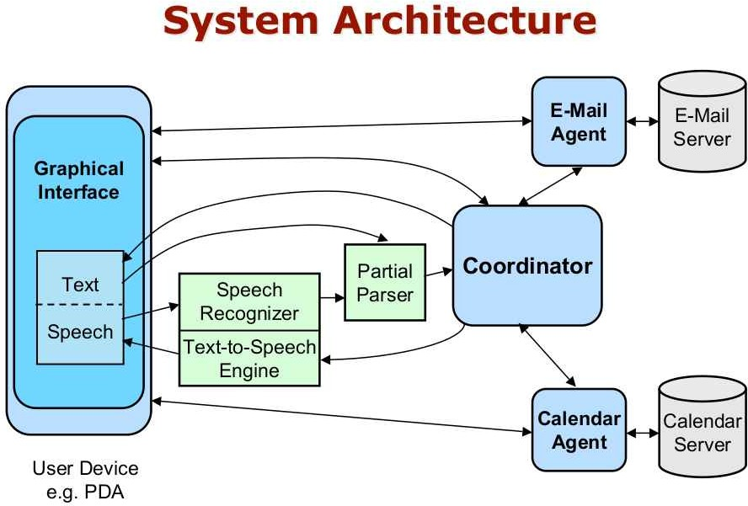
Methodology

Slide 6
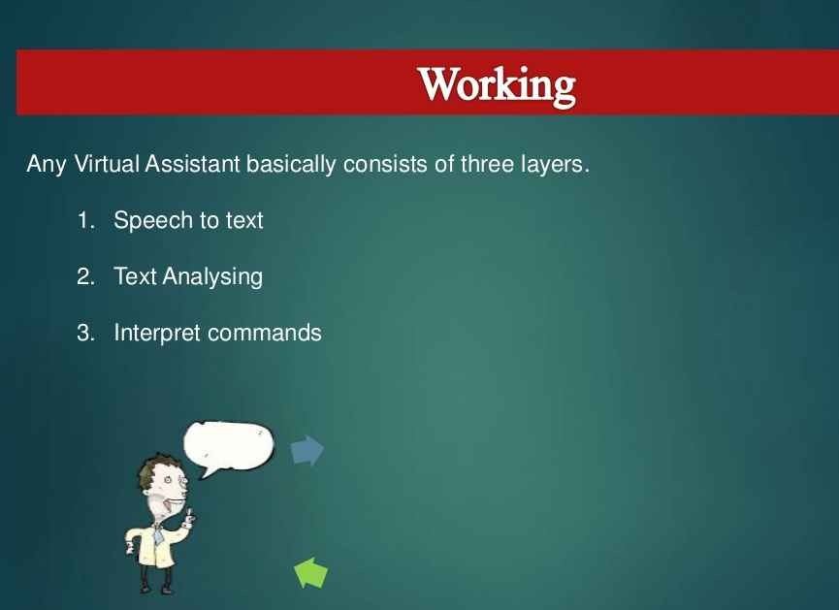

Slide 7
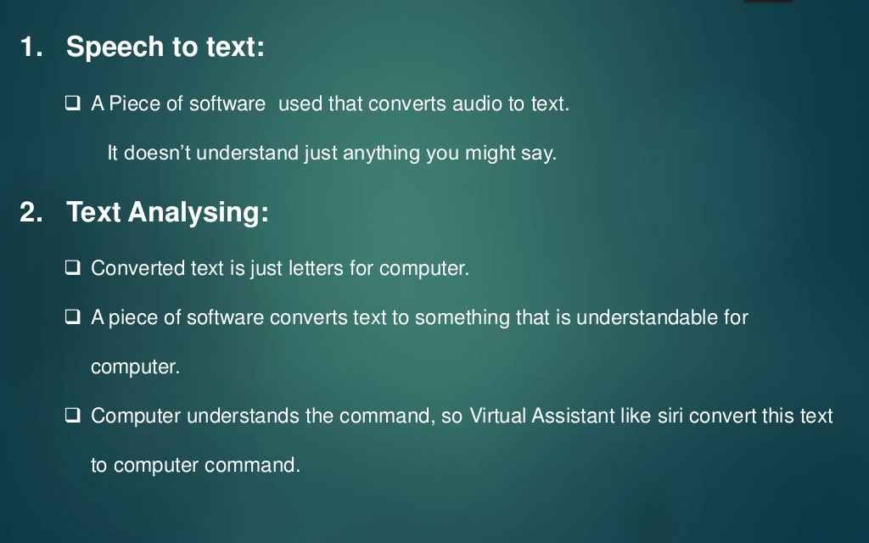
Working - Layers

Slide 8
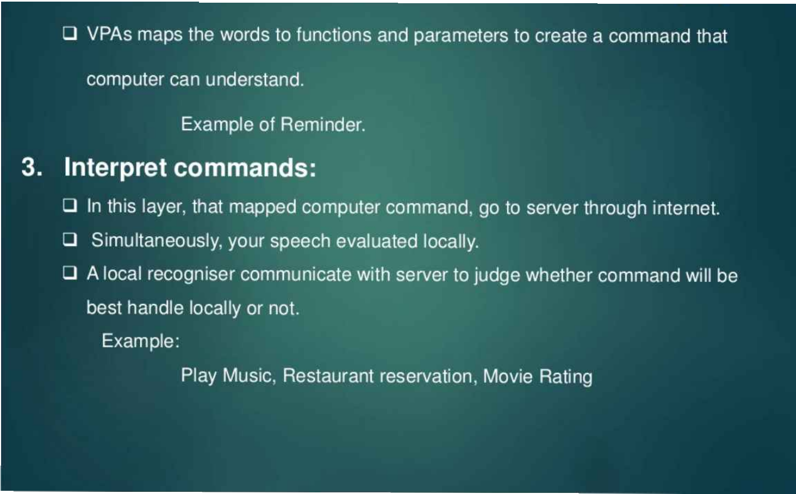

Slide 9
Basic software requirements
●
RasaNLU/RasaX: To identify intent and entities of the command.
●
Nltk: Python package for natural language processing algorithms implementation.
●
Google Speech-to-Text API: To convert speech to text.
●
Google Text-to-Speech: To convert text to speech.
●
Scikit-Learn: Required for splitting and imputing the data.
●
Keras: A tensorflow API for implementing deep learning(RNN in this case).
●
Basic internet access packages like requests, urllib, webbrowser etc
●
Re: For parsing texts

Slide 10
Result Screenshots

Slide 11
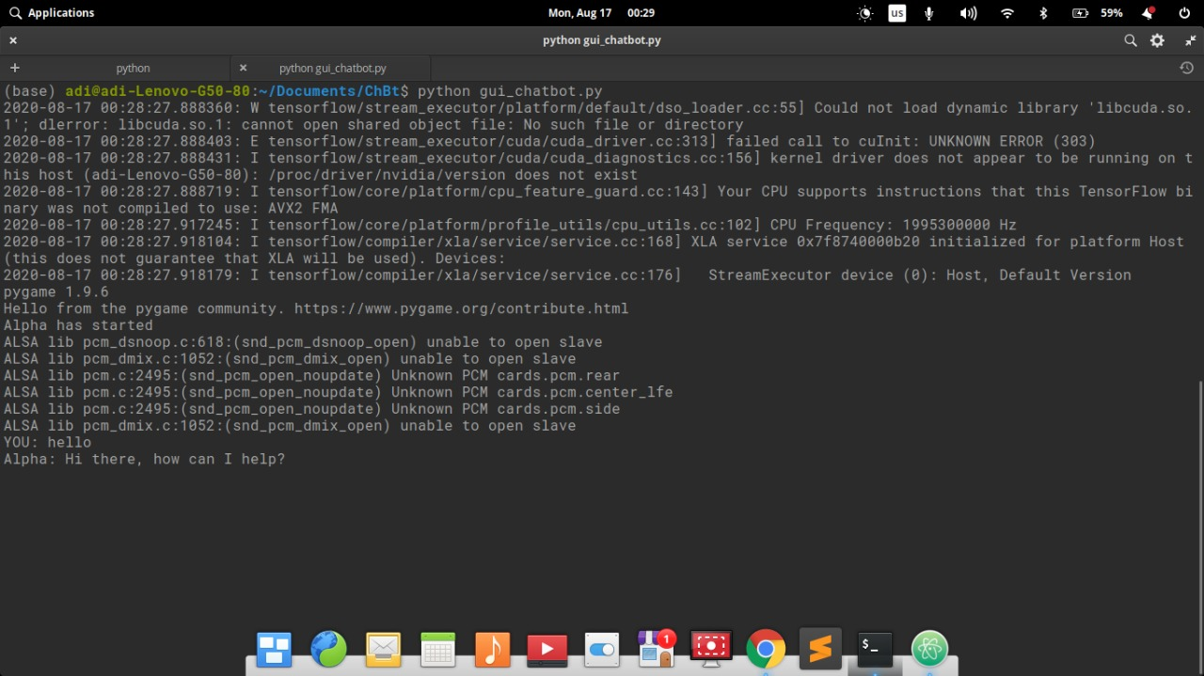

Slide 12
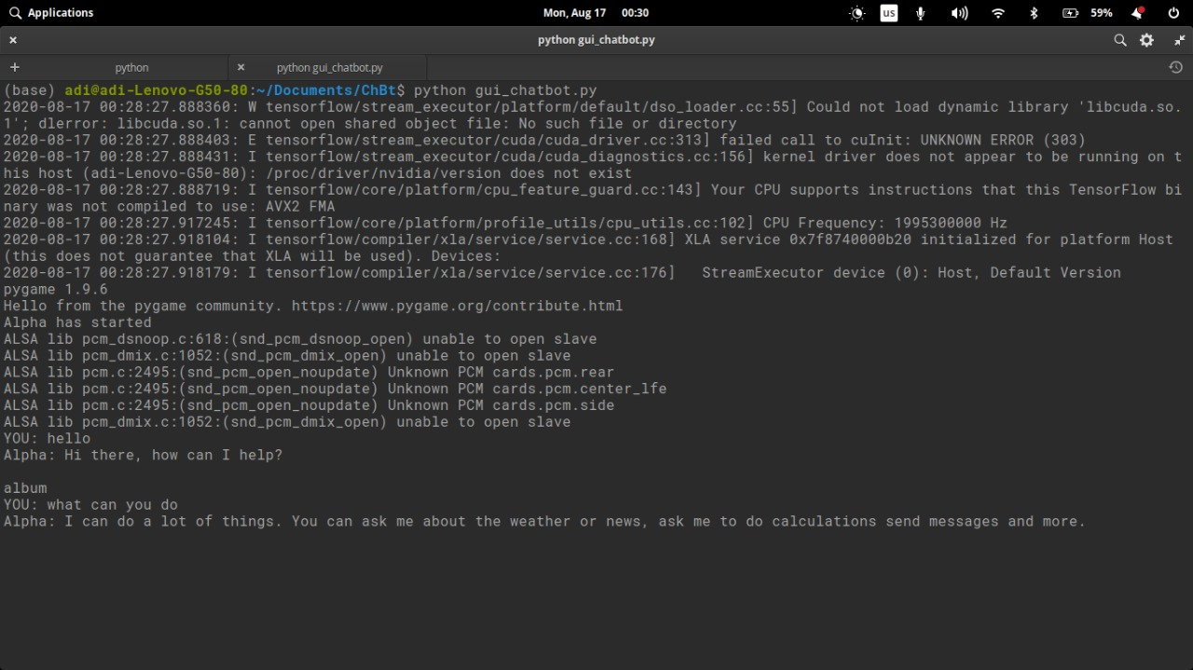

Slide 13
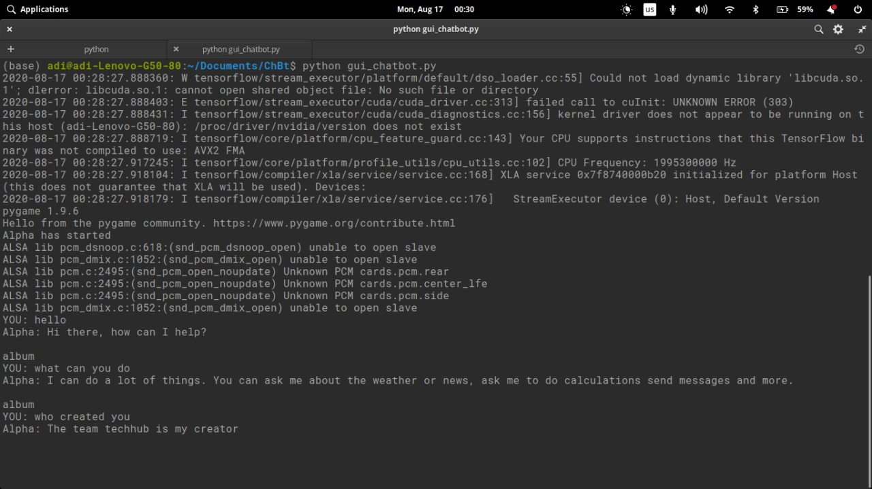

Slide 14
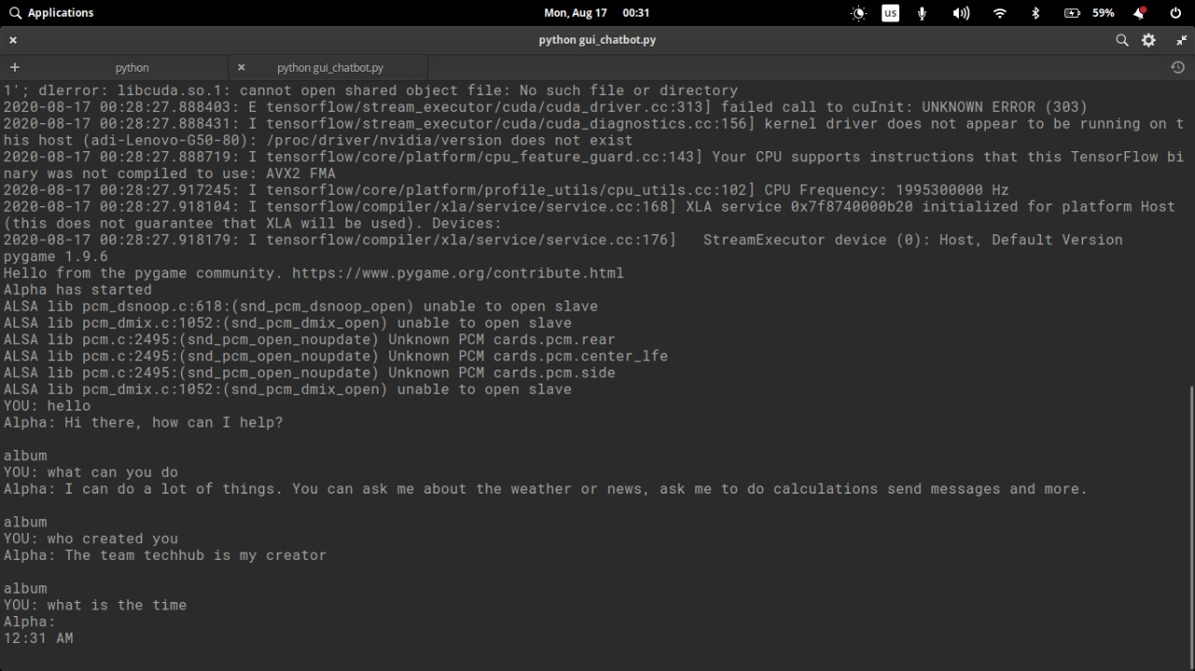

Slide 15
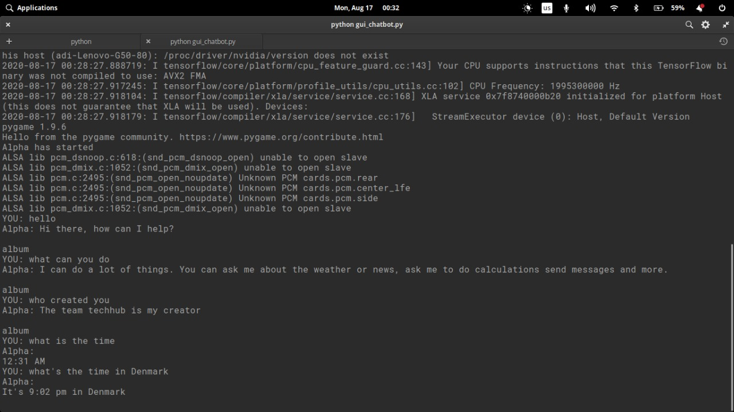

Slide 16
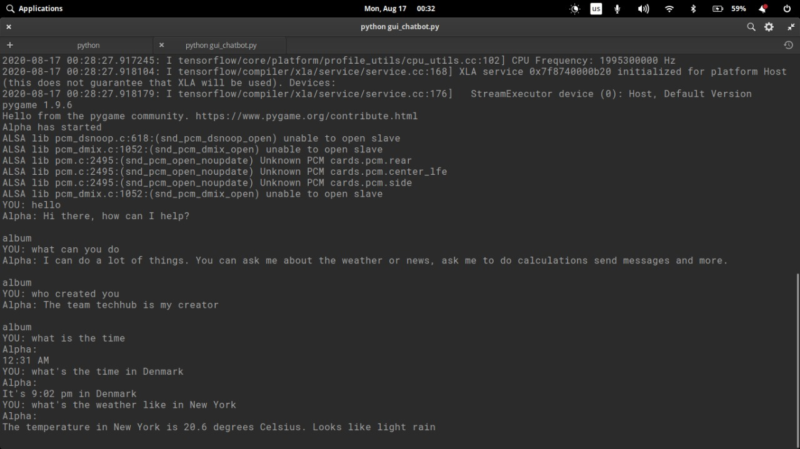

Slide 17
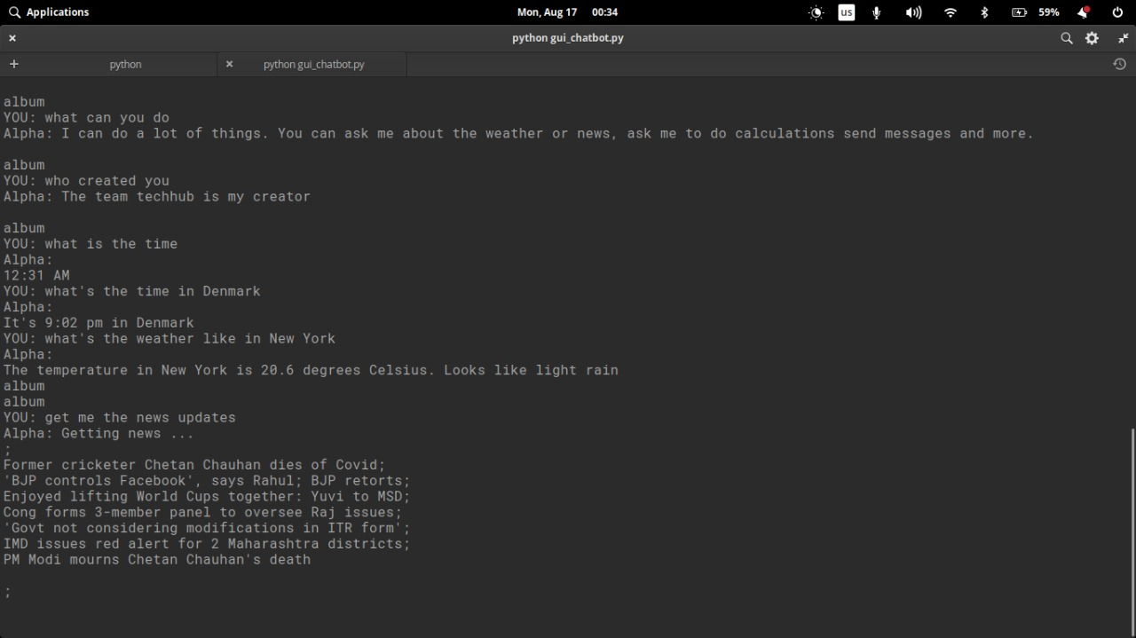

Slide 18
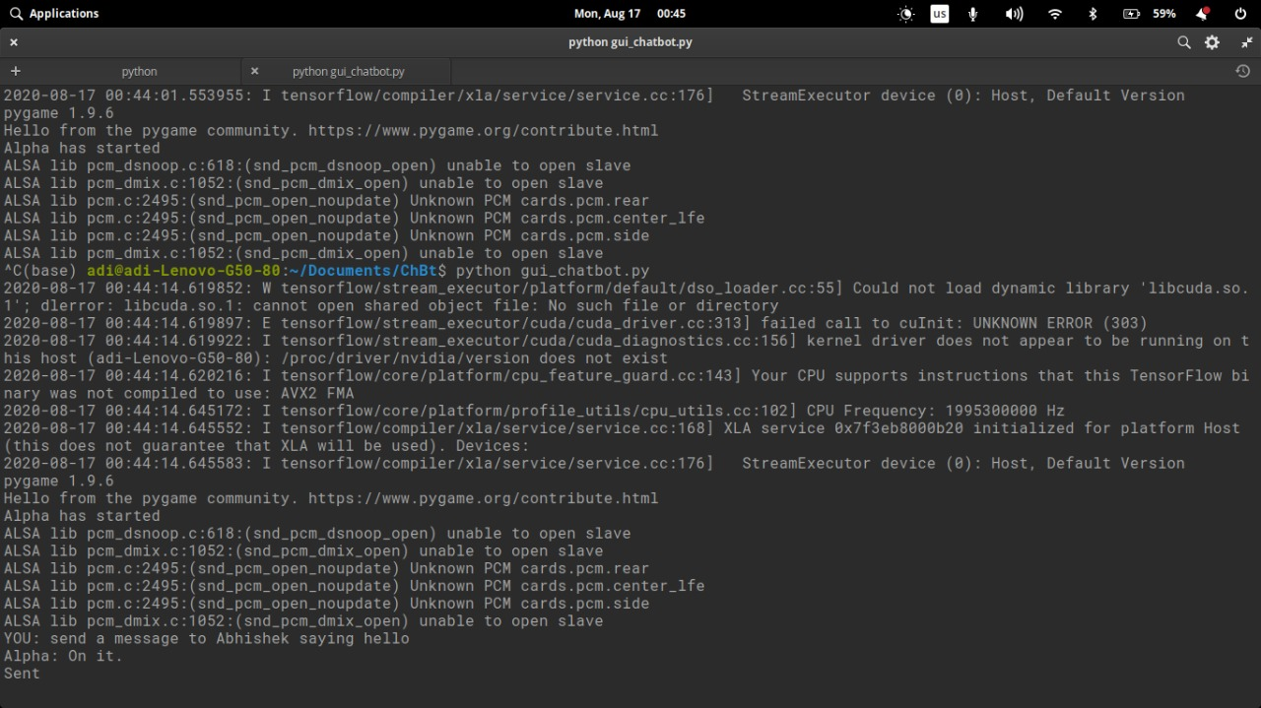

Slide 19
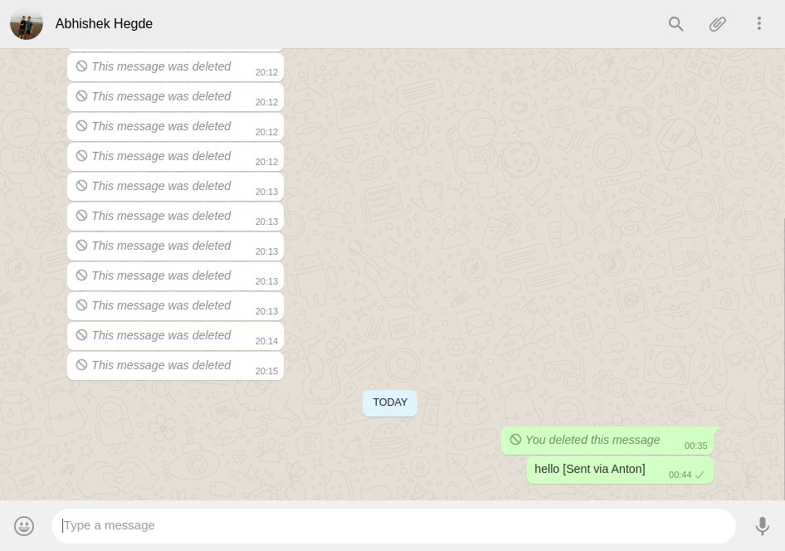

Slide 20
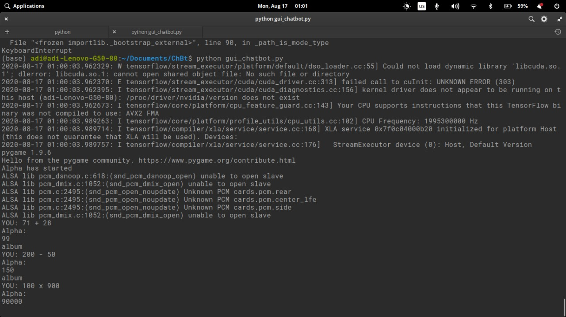

Slide 21
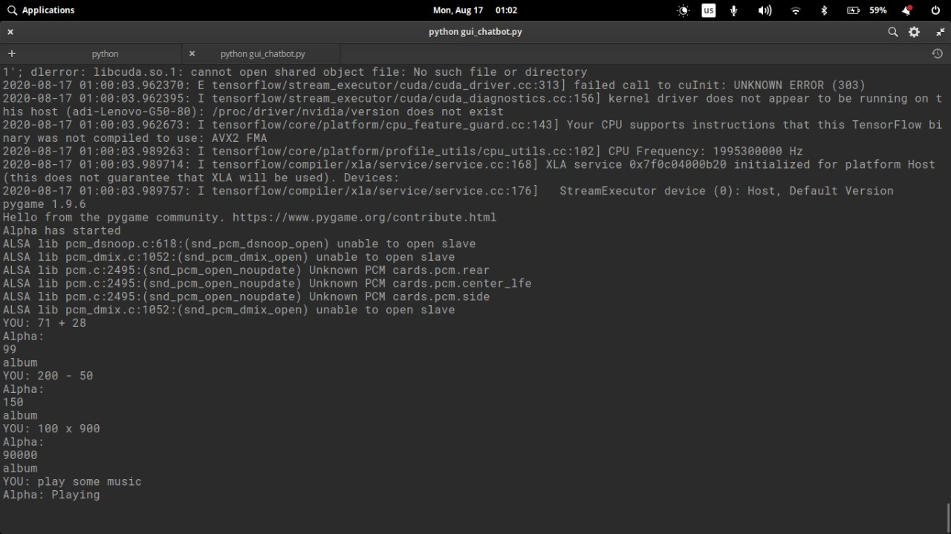

Slide 22
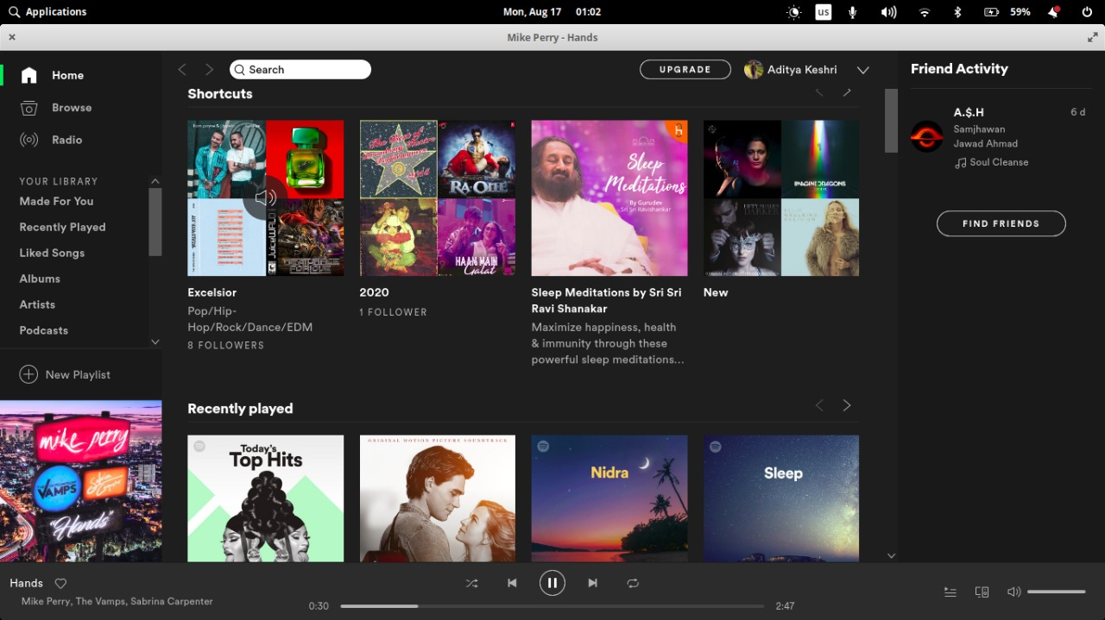

Slide 23
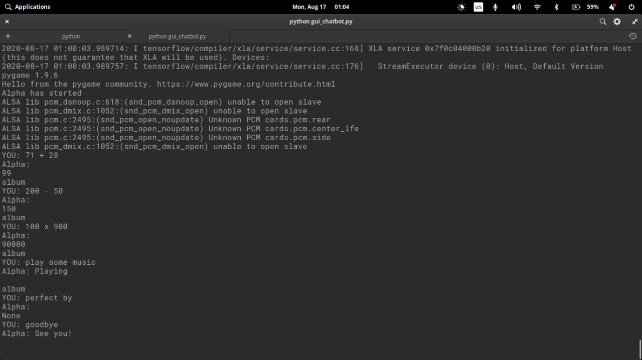

Slide 24
Basic functionalities
Talk with trigger such as basic conversations, telling jokes
Assisting interactions such as sending messages or mails, playing music.
Provide information such as weather, joke, time, do calculations etc.
Query databases such as contacts or other custom databases.

Slide 25
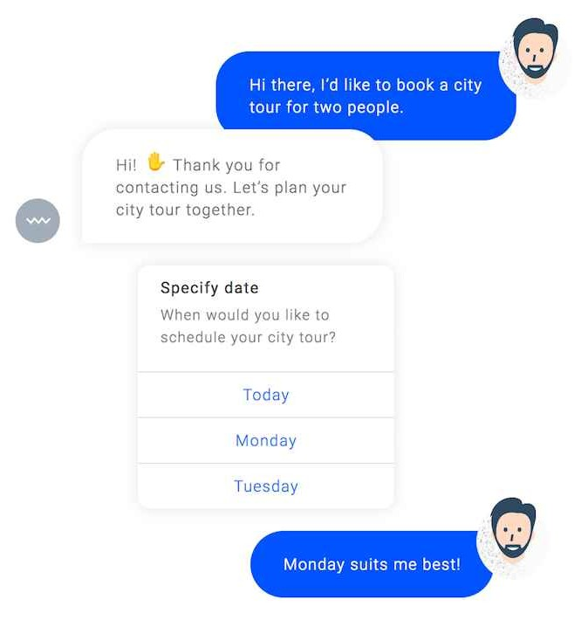
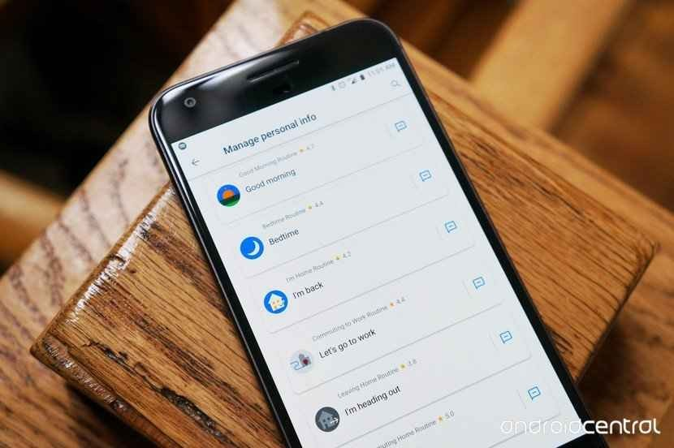
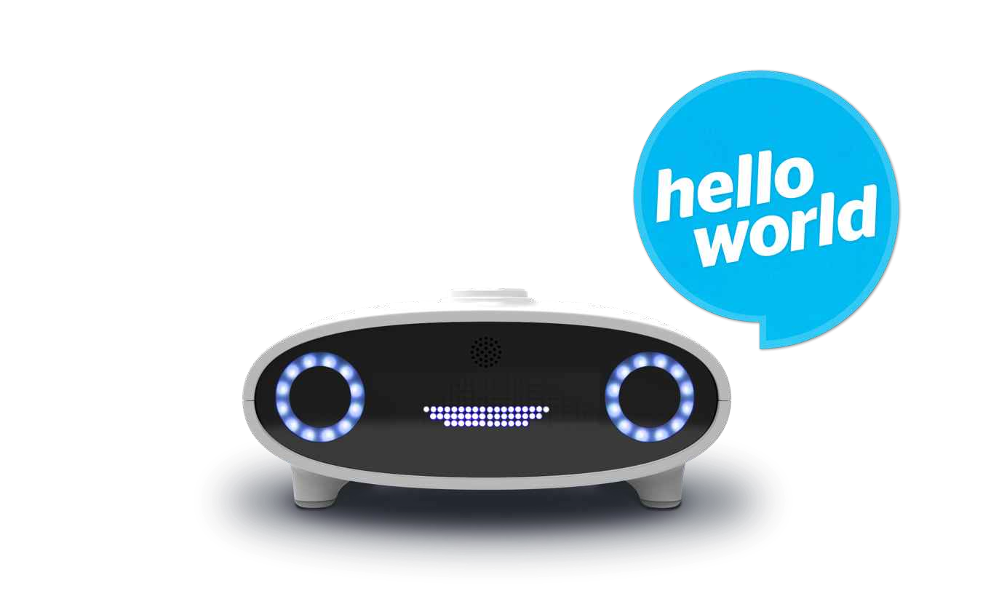
Future targets
Integration with mobile devices
Commercialised chatbox
Standalone assistant using Raspberry Pi

Slide 26
Conclusion
Through this voice assistant, we have automated various services using a single line command. It eases most of the tasks of the user like searching the web, retrieving weather forecast details, vocabulary help and medical related queries. We aim to make this project a complete server assistant and make it smart enough to act as a replacement for a general server administration. The future plans include integrating Anton with mobile using React Native to provide a synchronised experience between the two connected devices. Further, in the long run, Anton is planned to feature auto deployment supporting elastic beanstalk, backup files, and all operations which a general Server Administrator does. The functionality would be seamless enough to replace the Server Administrator with Anotn.

Slide 27
References
Digital Personal Assistant for the Enterprise2013 Intel White Paper.
Comerford, L, Frank, D, Gopalakrishnan P, Gopinath R and Sredivya J. 2001 The IBM Personal Speech Assistant Acoustics, Speech, and Signal Processing Proc. Of International Conference on Speech and Signal processing, 1 1-4
Paul Taylor 2007, Text-To-Speech Synthesis University of Cambridge pp 45-56. [5] Tom M. Mitchell 1997, Machine Learning, McGraw Hill pp 88-92.

Slide 28
Thank You!

